Slide 1
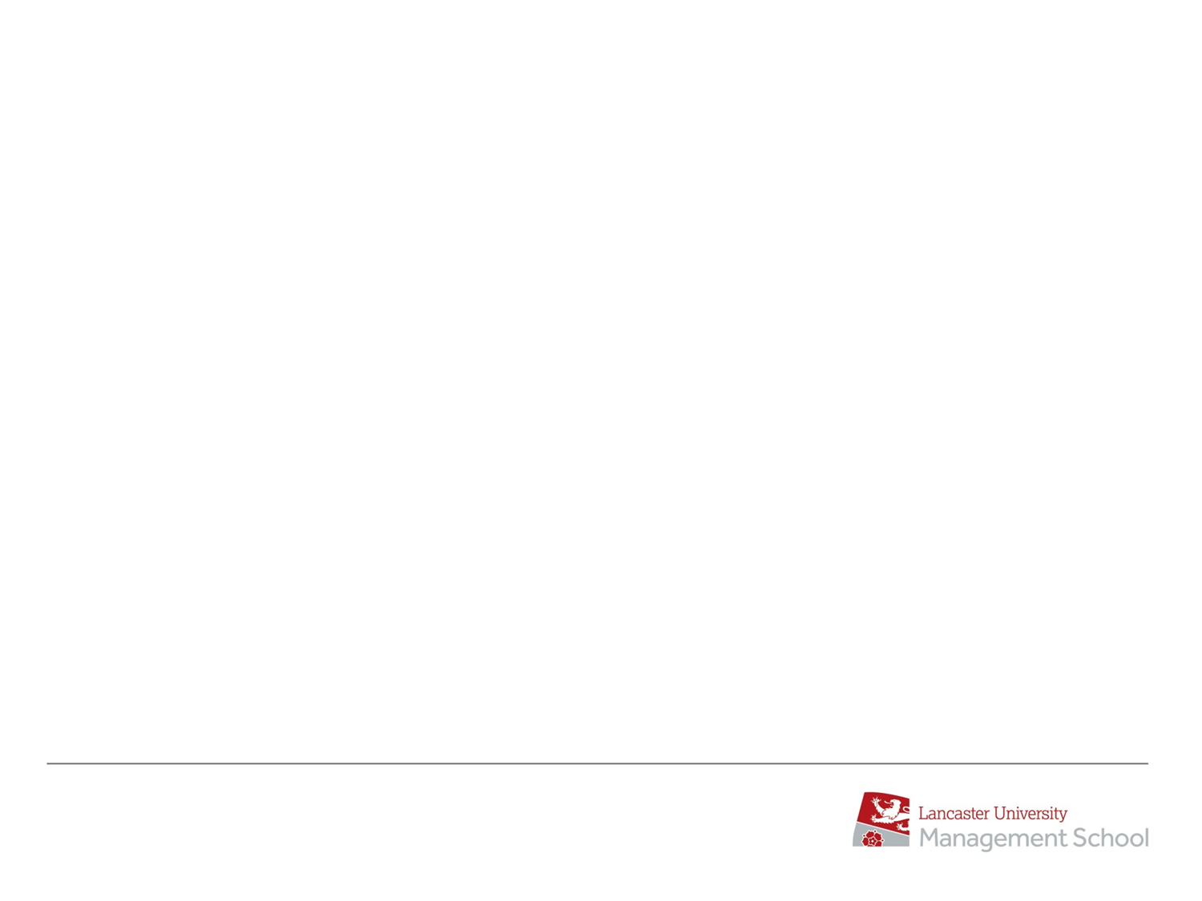
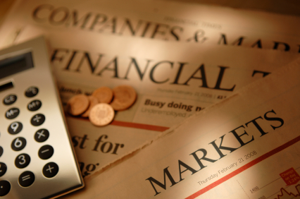
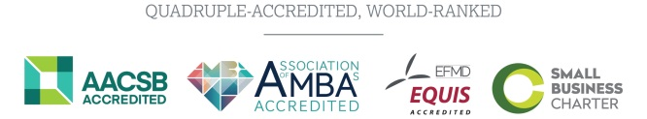
AcF 304 Financial Markets Commercial Awareness Session
Session Code
240887

Slide 2
Fortnightly Lecture - Friday 11 AM What is this session?
Session Code
240887
Commercial Awareness
= What is going on in Financial Markets today?
Session about 40 - 50 mins
Weeks 12,14,16,18

Slide 3
Commercial Awareness
How will I be assessed
= Circa 10% of End Term Test / Summer exam
Session Code
240887

Slide 4
Commercial Awareness
How will I be assessed?
I will not ask some obscure data questions but rather questions on the 15 or so main topics and themes that we discuss and follow.
I will give verbal guidance at lectures

Slide 5
Commercial Awareness
Slides will be posted on Moodle BUT
..the slides on their own lack the level of detail you need understand the topic which only achieved by lecture attendance
So you need to grasp the content here and it may take a few weeks to for it all to come together

Slide 6
Commercial Awareness
We might get ahead of ourselves e.g.
You may discuss Bonds, Stocks and other concepts in detail later in the module but we need to talk broadly about stocks and bonds right away.

Slide 7
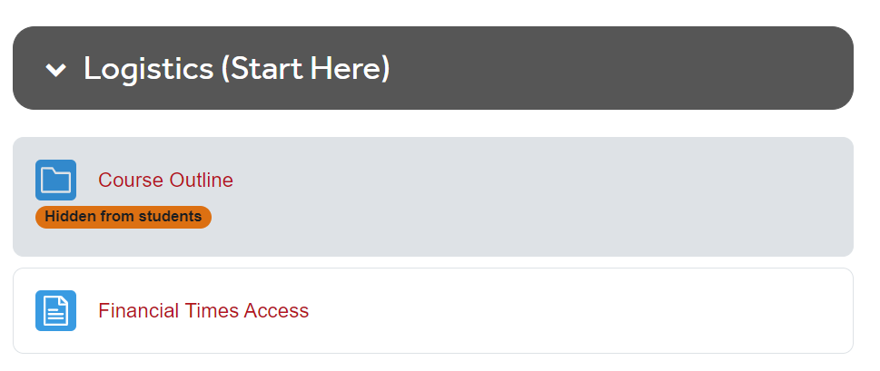
Commercial Awareness / FT Access
The one financial instrument you MUST follow is the yield on the 10-year US Government Bond
Everyone has access to the Financial Times

Slide 8
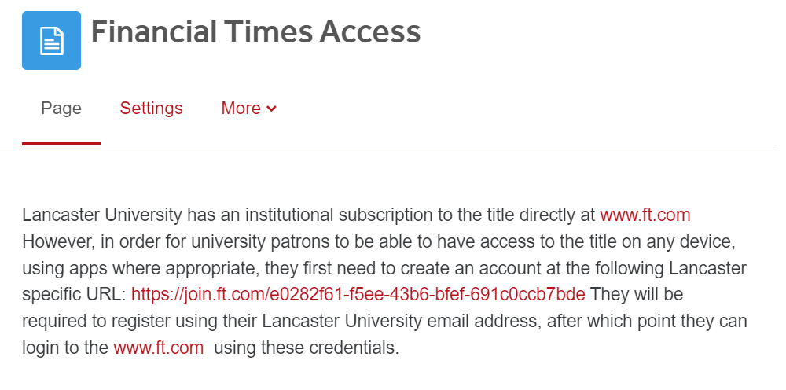

Slide 9
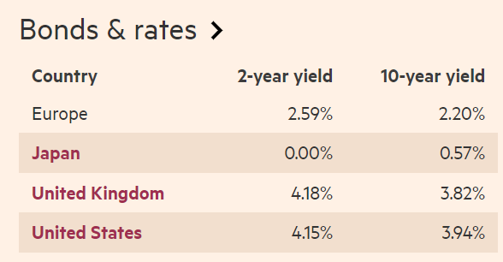
The one financial instrument you MUST follow is the yield on the 10-year US Government Bond
Markets >Market Data? Jan 2024 !!!

Slide 10
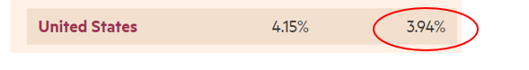
We’ll talk a lot about Interest Rates
Bond yields are Interest Rates
3.94 % = annual rate of return /Yield-to-Maturity / interest rate that an investor will receive by buying 10-year US Treasury Bond
3.94% = the amount of annual interest the US Government will have to pay you to borrow your money i.e. US Governments ‘cost of capital’

Slide 11
Observations…
Markets >Market Data? Jan 2024 !!!

Slide 12
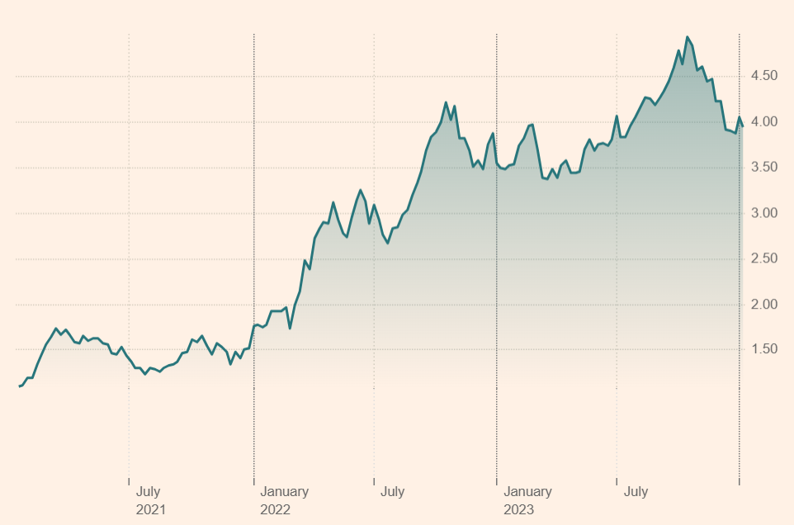
US 10-year bond yield / interest rates – Last 3 years

Slide 13
Let’s remember a key bond concept..
Bond yields and prices have an inverse relationship
Yields up = Prices Down…losses for bondholders
Yields down = Prices Up…profits for bondholders

Slide 14
All US / Global Interest Rates are very sharply UP

Slide 15
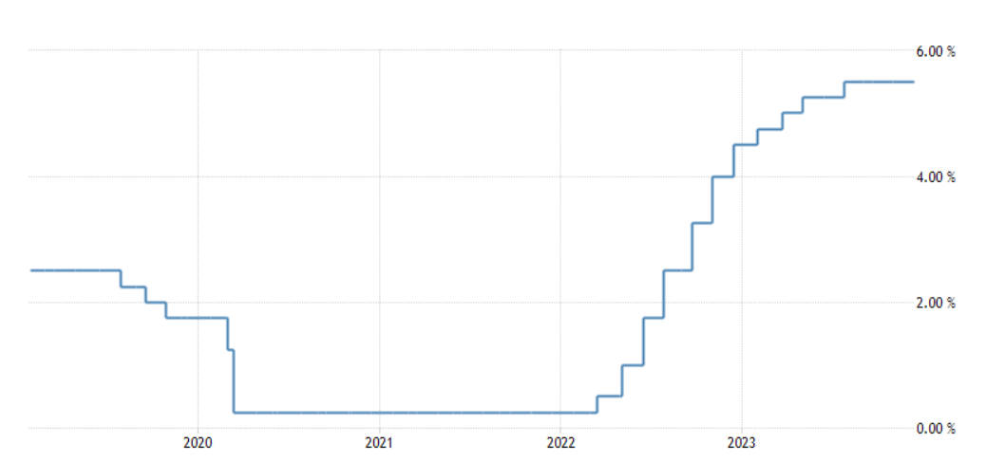
All US / Global Interest Rates are very sharply UP – US ‘Fed Funds Rate’

Slide 16
Why has the US 10-year yield risen in last 24 months?
Inflation

Slide 17
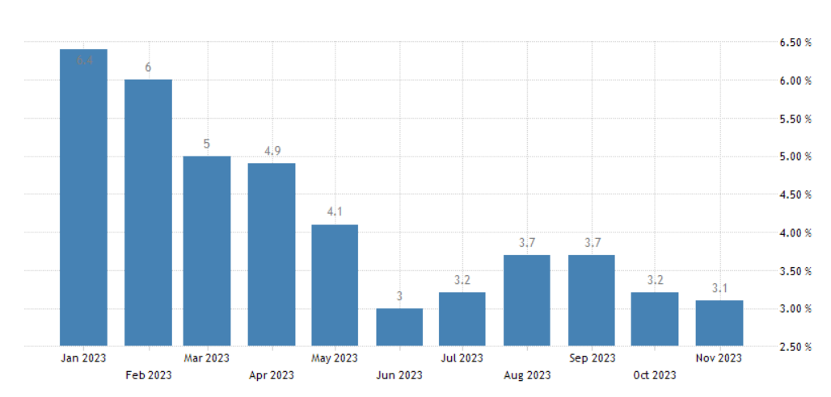
Inflation in the US and UK
Inflation US versus 2% target

Slide 18
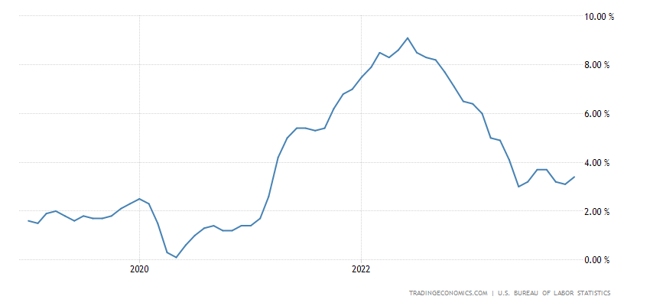
Inflation in the US and UK
Inflation US versus 2% target

Slide 19
US ‘Fed Funds Rate’

Slide 20
Higher Interest Rates are bad for bond prices / bondholders
Yields up = Prices Down…losses for bondholders

Slide 21
Higher interest rates are bad for stocks since…
Higher interest rates make investing in bonds relatively more attractive versus stocks
Interest Rates are 0.5% = I’ll put money in stock market
Interest Rates are 6.0% = I’ll put money in bonds

Slide 22
Higher interest rates are bad for stocks since…
Higher interest rates/bond yields raise the cost of corporate borrowing
e.g. If Coca Cola has to issue a 10-year bond at 5% not 2% that directly increases their borrowing costs/decreases profitability = company is less valuable = stock price will fall

Slide 23
Higher interest rates are bad for stocks since…
Higher interest slow the economy down so reducing corporate profitability
Making companies less valuable = stock price falls

Slide 24
Higher interest rates are bad for stocks since…
Higher interest rates result in lower present day stock valuations as analysts discount future earnings using higher interest / discount rates
e.g. $1 MM earnings in 5 years is worth $1MM today if interest rates /inflation are zero for next 5 years
e.g. $1 MM earnings in 5 years is worth a lot less if interest rates/inflation are 6% for next 5 years (think real values)

Slide 25
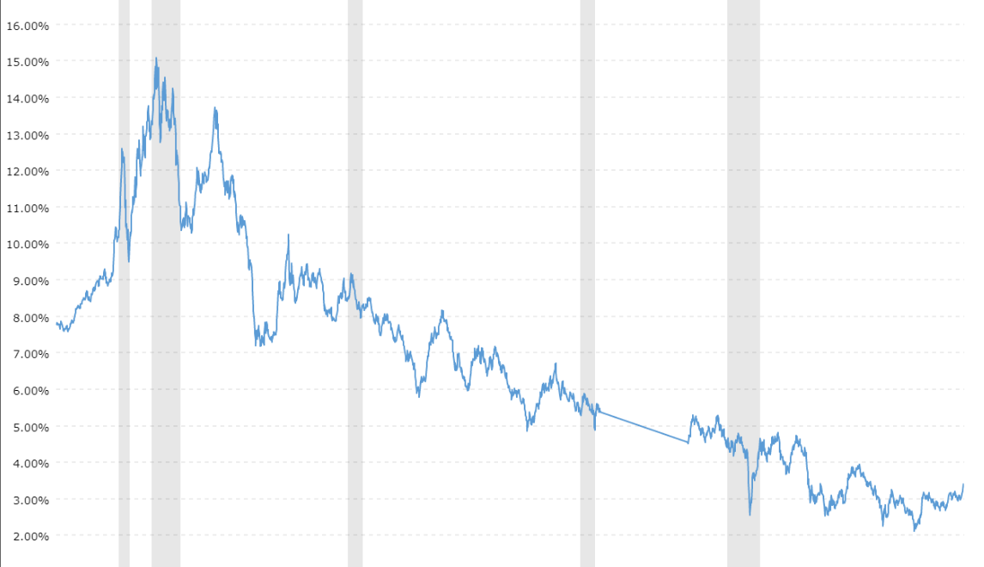
US 10-year bond yield – Last 30 years

Slide 26
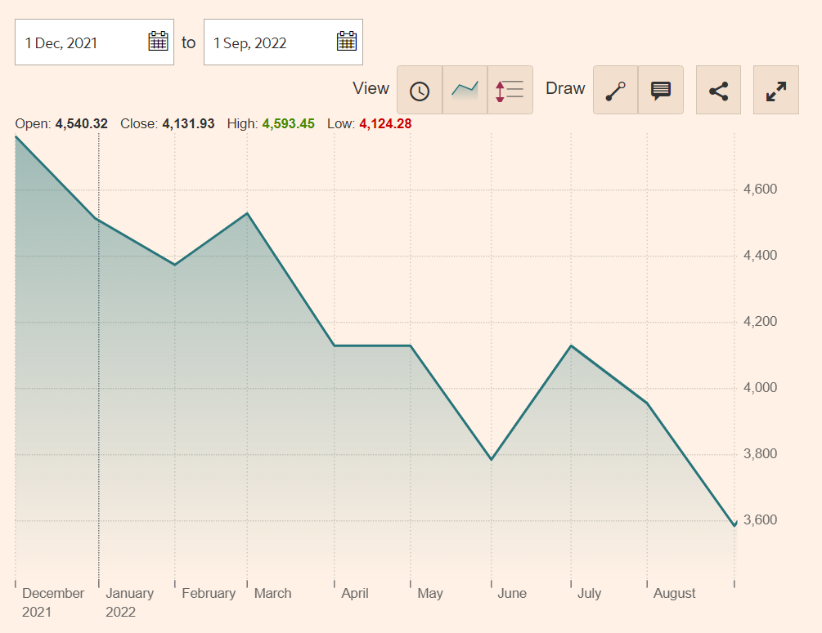
2022 US Stock Market – S&P 500

Slide 27
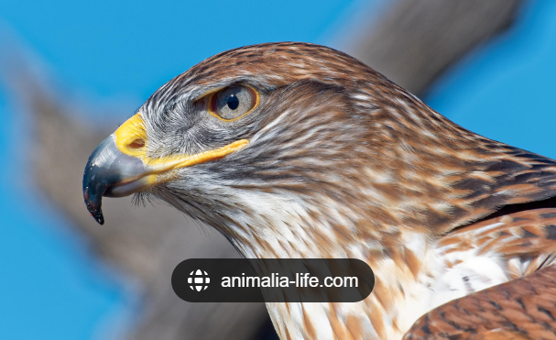
So, US and Global Interest Rates have gone up a lot over the last 18 months
This is Hawkish environment – market language
If interest rates are going up or the Central Banking is talking about interest rates going up in the future = Hawkish

Slide 28

So US and Global Interest Rates have gone up a lot over the last 18 months
If interest rates are going down or the Central Banking is talking about interest rates going down in the future = Dovish
“ The market went up yesterday because a Fed Official made Dovish comments…”

Slide 29
All US / Global Interest Rates are very sharply UP – US ‘Fed Funds Rate’
How does this actually work?

Slide 30
US Federal Reserve
Meet every 6 weeks
Discuss the economy
Decide if interest rate adjustment needed
It is the Federal Funds or ‘Fed Funds Rate’ they adjust
‘Fed Funds’ = the rate that banks can borrow from / or lend to each other on an Overnight Basis
Trades in a 0.25% range – Now 5.25% - 5.50%
If interest rates are going up or the Central Banking is talking about interest rates going up in the future = Hawkish

Slide 31
So after each meeting…
The FED releases a press statement
The FED holds a press conference and take questions
The audience listens to every single word to gain a clue to FED monetary policy and markets will react IMMEDIATELY to Hawkish or Dovish comments

Slide 32
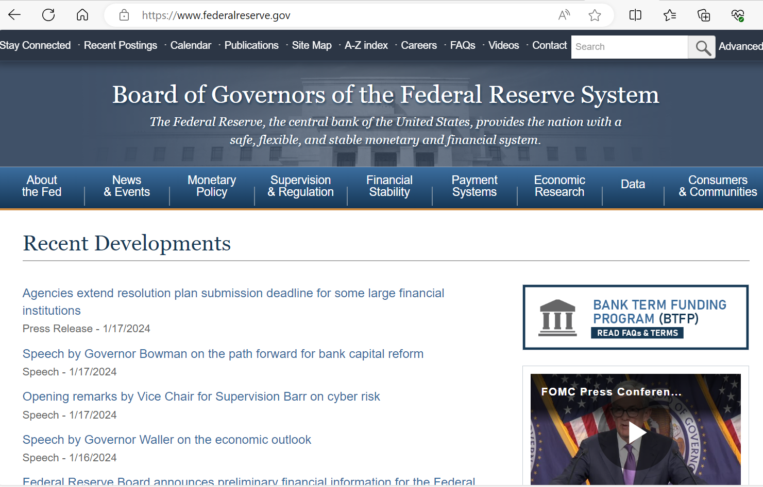

Slide 33
Federal Reserve Board - Home

Slide 34
Nov & Dec 2023 the Federal Reserve went from Hawkish to mildly Dovish
– significantly & positively impacting financial markets

Slide 35
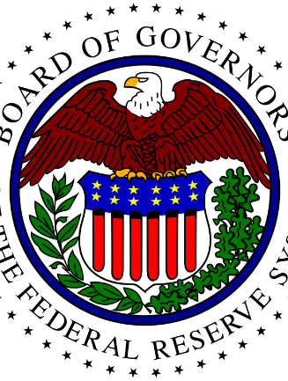
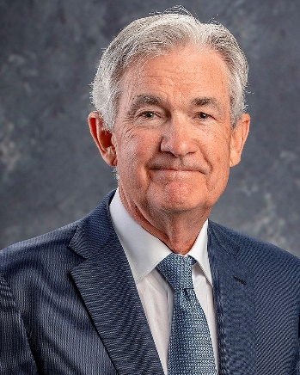
Nov & Dec 2023 the Federal Reserve went from Hawkish to Dovish
Federal Reserve Systems’ Great Monetary Pivot

Slide 36
What is the Federal Reserve Pivot?
Federal Reserve’s end 2023 Great Monetary Pivot
Up until Oct 2023 US Interest Rate rose from 0.25% to 5.25%
Federal Reserve confirmed that interest rates will stay at 5.25% in December
Fed has started talking about 2024 interest rate cuts which the market wasn’t really expecting
US Interest Rates

Slide 37
What is the Federal Reserve Pivot?
Federal Reserve’s end 2023 Great Monetary Pivot
With this Dovish language…
Bond yields have move dramatically lower (Bond prices higher)
Equity prices…dramatically higher

Slide 38
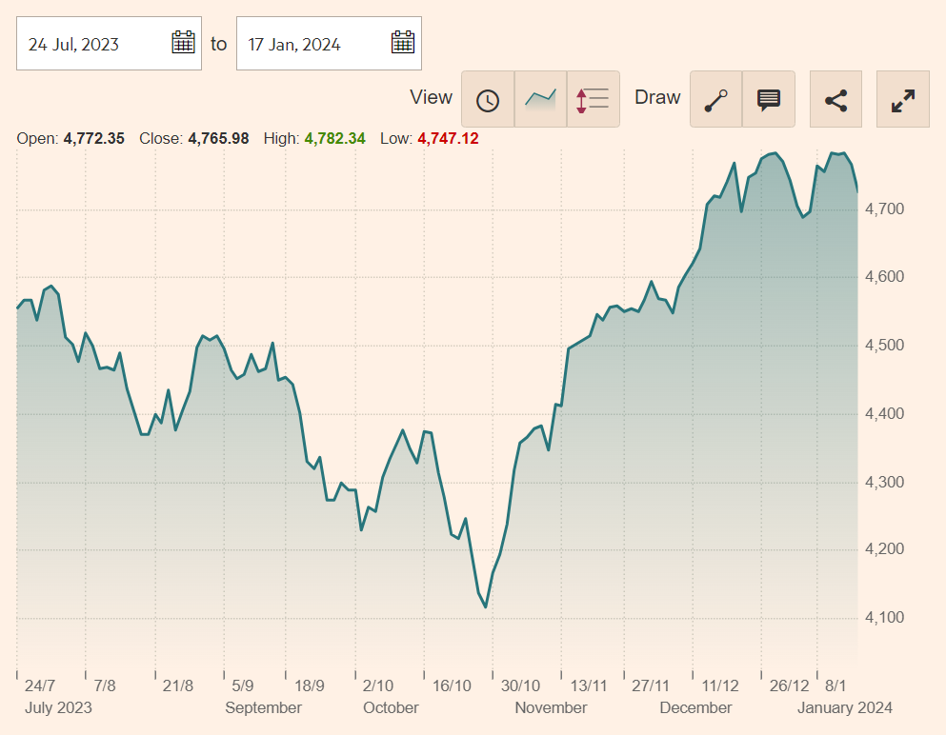
S&P 500

Slide 39
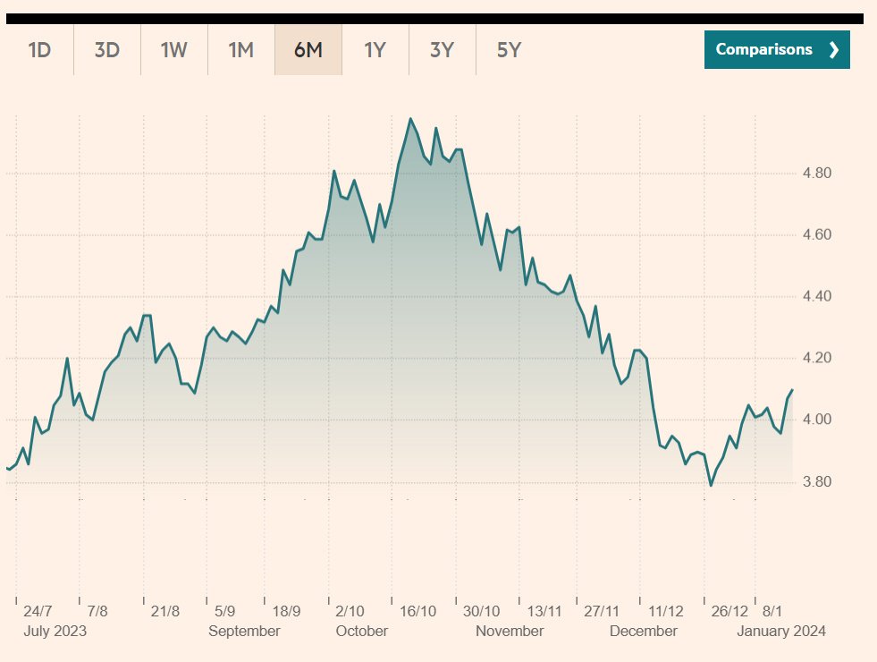
The Sharp Growth in Valuations of the US Bond and Equities Market
US 10-year Bond Yield

Slide 40
Question: At the end of 2023 the US Federal Reserve significantly pivoted on interest rate policy. What does this mean? What effect did this have on bond and stock prices and why?
What is the Fed Fund Rate and why key?
What was the Fed Funds direction in the 18 months up until Oct 2023?
Why was this bad for stock and bond prices
End 2023 - What did the FED say about the outlook for interest rates? (Dovish? Hawkish?)
What did stock and bond prices do and why?
If interest rates are going up or the Central Banking is talking about interest rates going up in the future = Hawkish

Slide 41
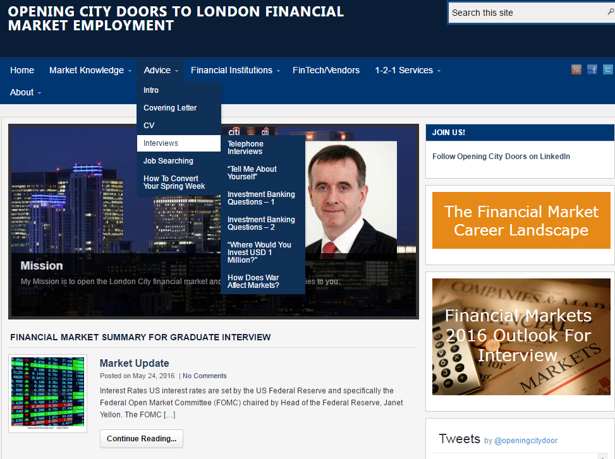
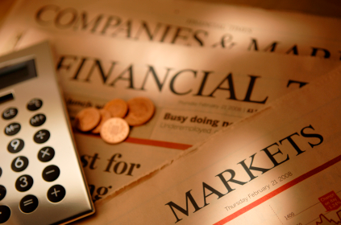

You need Commercial Awareness
openingcitydoors.co.uk

Slide 42
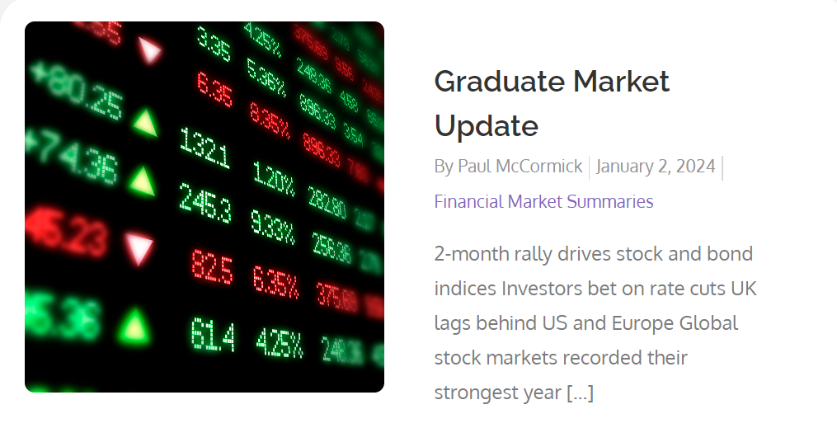

Slide 43
With Inflation Going Up
US Bond Yields / Interest Rates Going Up Means Two Things…
Losses for bond holders - due to inverse relationship between bond prices and bond yields i.e
Bond yields up = bond prices down
Bond yields down = bond prices up
Equity Market Falls

Slide 44
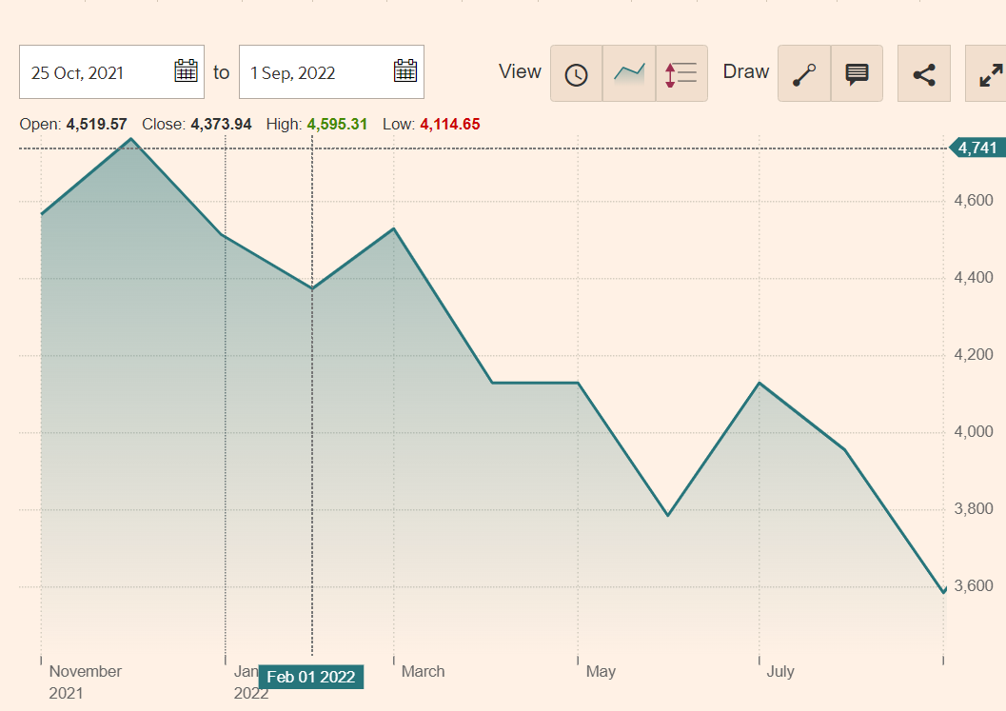
2022 - Everything was down !!!

Slide 45
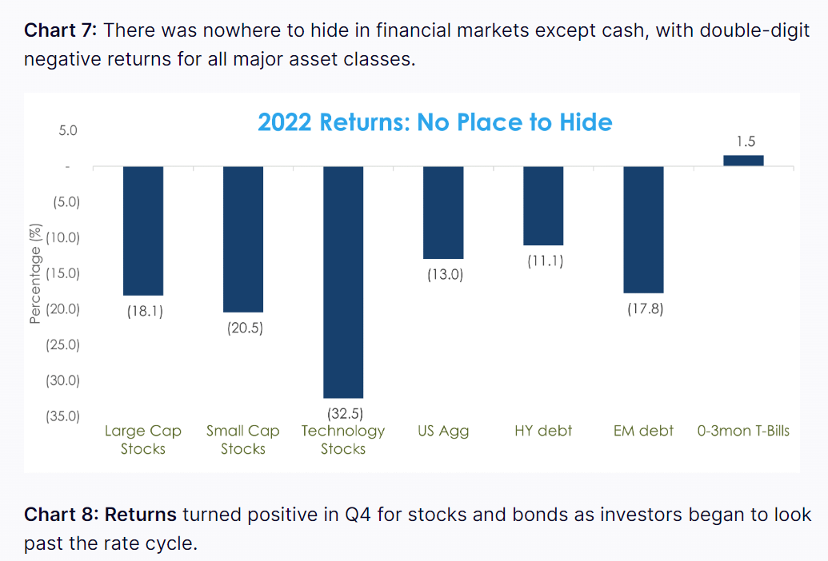
2022 - Everything was down !!!

Slide 46
2022 – Everything was down!!!
Classic portfolio theory was broken in 2022!

Slide 47
Classic portfolio theory was broken in 2022!
Traditionally = 60% stocks / 40% bonds

Slide 48
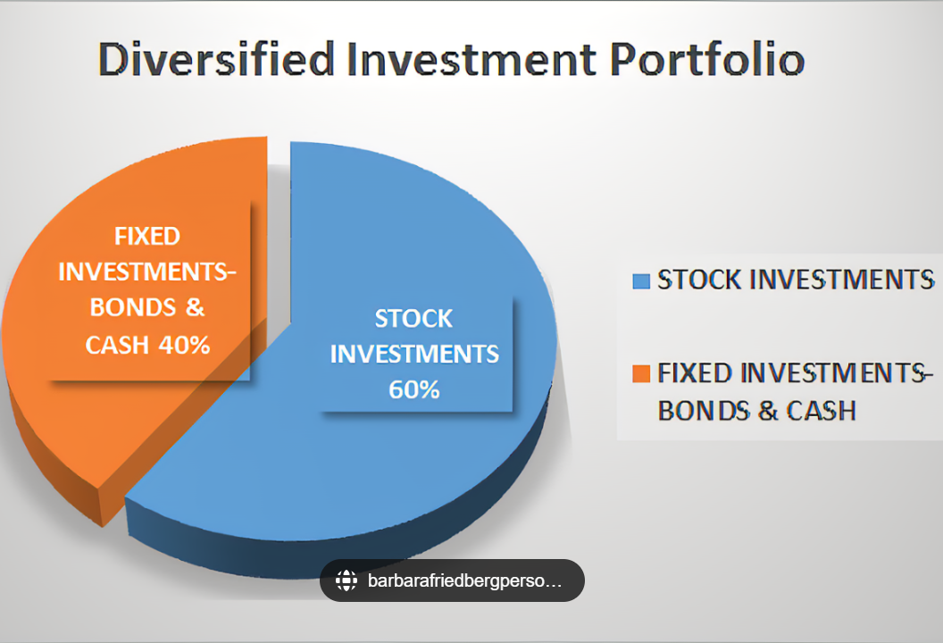
Classic Portfolio Theory

Slide 49
Classic Portfolio Theory
Traditionally = 60 per cent stocks / 40% bonds
If economy is strong – stocks will do well – but bonds not so well interest rates / inflation goes up = balanced result
If economy is weak /recession – stocks will do badly – but bonds will do well as inflation /interest rates go down = balanced result

Slide 50
Classic portfolio theory was broken in 2022!
Traditionally = 60 per cent stocks / 40% bonds
In 2022 = Minus 17%!!!
$10 trillion was lost!

Slide 51
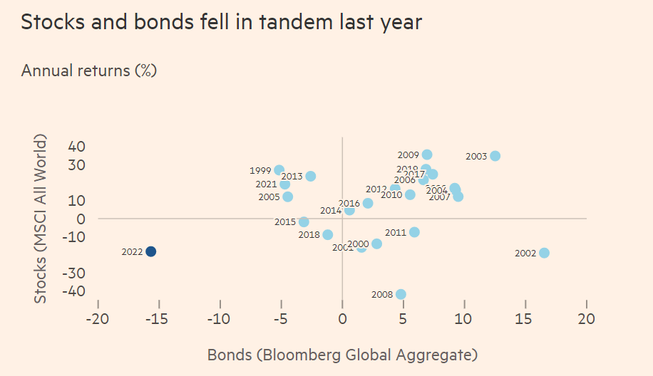

Slide 52

Classic portfolio theory was broken in 2022!
Does classic portfolio theory work anymore!!!
Traditionally = 60% / 40% bonds
Roughly $100 Trillion is invested this way and it has been the strategy for last 70 years

Slide 53
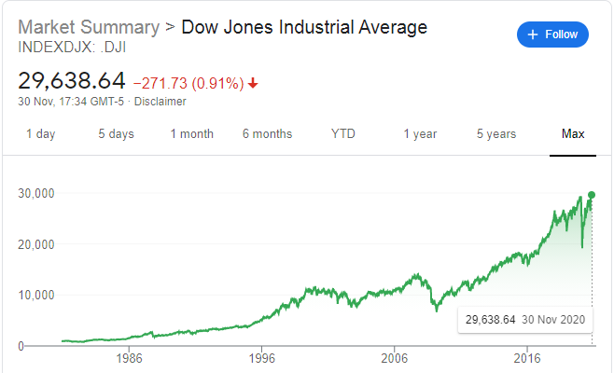
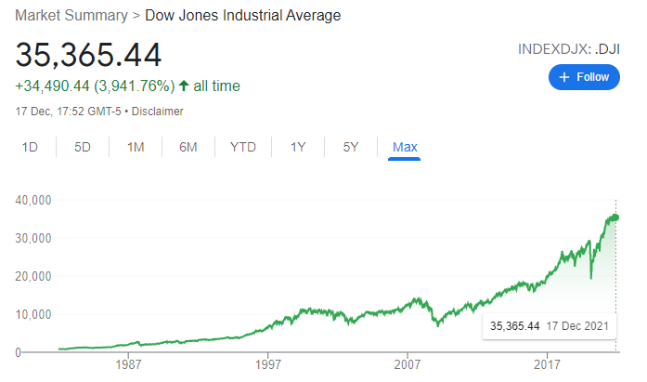
Stock Prices as Measured by the Dow Jones Industrial Average, 1980–2021
MISCELLANEOUS 1
(Stock investing seems to work in long term)

Slide 54
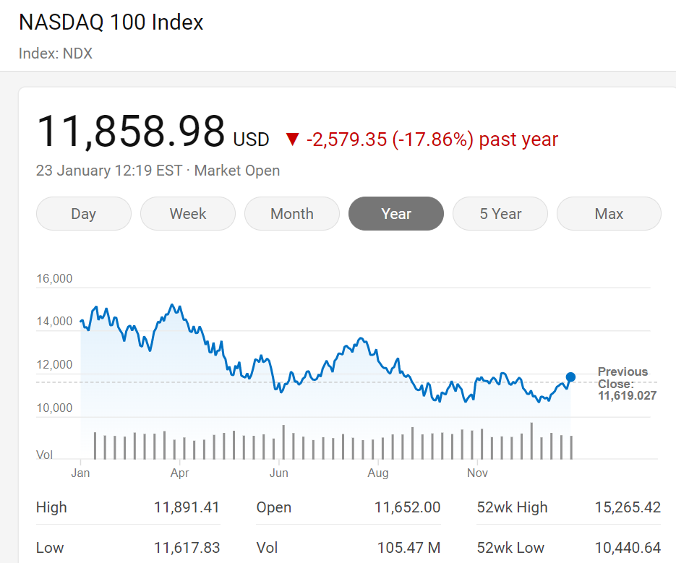
2022 – NASDAQ fell harder!
MISCELLANEOUS 2

Slide 55
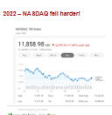
NASDAQ = Technology Stocks – think Tesla, Apple
Growth stocks that investors buy for capital growth – they pay very little dividends
If interests rates go up can look particularly unattractive

Slide 56
If interest rates go up to 5%
S&P 500 stock paying 3% dividends
NASDAQ = paying 0.25% dividend
NASDAQ stocks will fall more

Slide 57
Key themes today – reference 2022
Interest rates / bond yields up / bond prices down
Equity prices down
Why inflation bad for stock market (and bonds)
How the FED makes decision and communicates
Market language – Dovish & Hawkish
Inflation up
NASDAQ fell more than S&P 500
Classic portfolio theory broken (2022)
End 2023 Fed ‘pivoted’

Slide 58
AcF 304 Financial Markets Commercial Awareness Session See you in 2 weeks!
Session Code
240887

